Slide 1
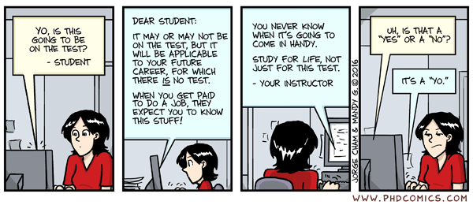
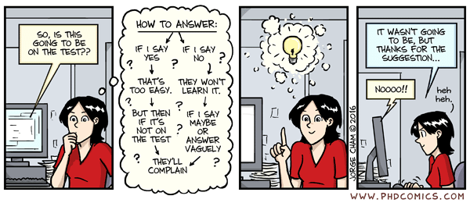
Comic of the day

Slide 2

CSE 204 - INTRO TO Database Systems Final Exam Information
Joseph LEDET
Department of Computer Engineering
Akdeniz University
josephledet@akdeniz.edu.tr

Slide 3
DATE/TIME/LOCATION
Date
09-June-2022
Time
10:30
Location
D205, D206, C201

Slide 4
GRADING INFORMATION
100 points
Represents 40% of Final grade

Slide 5
Topics Covered
All topics discussed in class
Everything from beginning of semester to Midterm Exam
Normalization (including advanced normalization)
Conceptual Database Design
Logical Database Design
Physical Database Design

Slide 6
Format
Short answer questions
Define important terms
Give Examples
Problems
Write SQL statements
Draw an E-R diagram
Understand traps
Know how to normalize a dataset
Long answer questions
Explain important concepts
Understand how to merge two databases

Slide 7
FINAL NOTE
Closed
Phone
Computer
Electrical Devices
Mouth
Open
Mind
1 “Notes Sheet” is allowed
All notes, printed material, textbook

Slide 8
Questions
[?]

